Slide 1
Machine learning 101

Slide 2
Plan of the presentation :
What is machine learning ?
What are the types of learning ?
Model examples ?
The machine learning Engineering workflow
Conclusion (Discuss a Hot Topic || propose Study plan | The master algorithm )

Slide 3
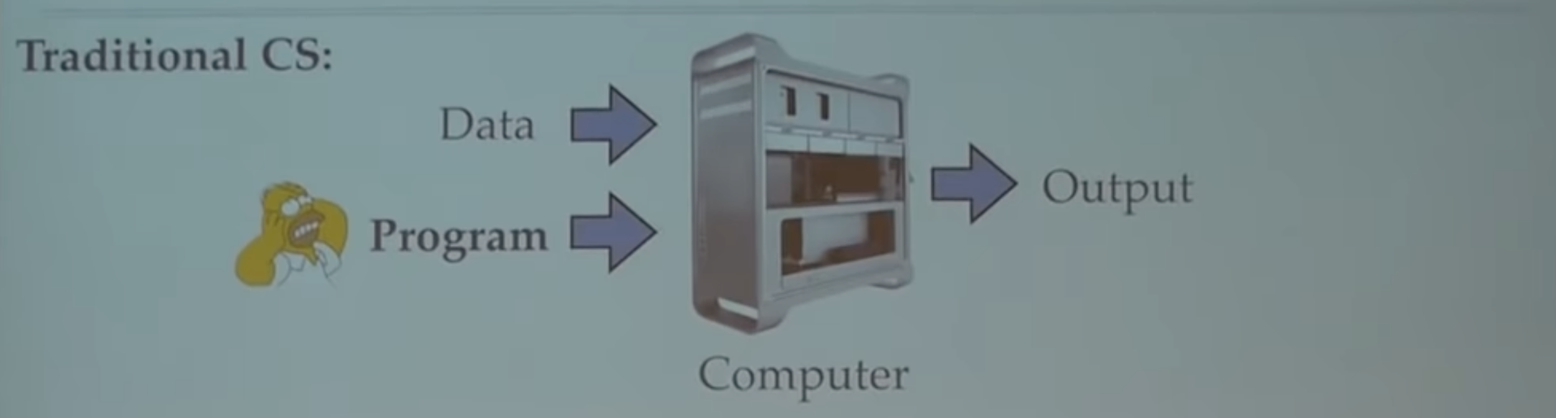
What is machine learning ?
Traditional Computer Science

Slide 4
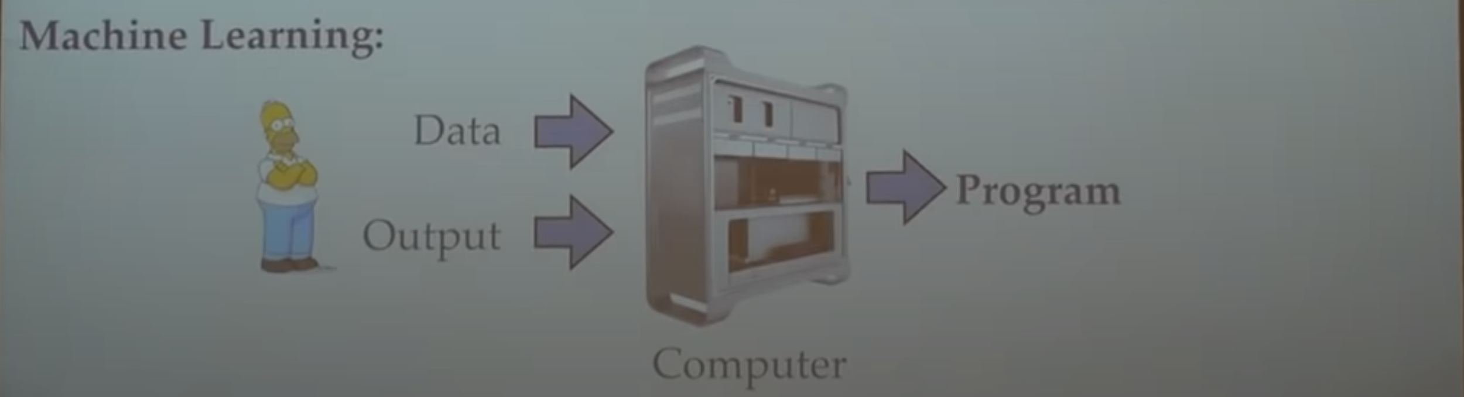
What is machine learning ?
Machine learning

Slide 5
What is machine learning ?
Formally : (Mitchell 1997) A computer program A is said to learn from experience E with respect to some class of tasks T and performance measure P, if it’s performance at the tasks T as measured by P improves with E
Informally : Algorithms that improve on some task with experience

Slide 6
What is machine learning ?
The task T :
Classification
Regression
Transcription
Machine translation
Structured input
Anomaly detection
Synthesis and sampling
Imputation of missing value
Denoising
PDF estimation (probability density functions)
The Experience E
Supervised (X,Y)
Regression
Classification
Unsupervised (X)
Reinforcement learning (Model dynamics , Sample Episodes )
The performance P
Accuracy
Loss
Recall

Slide 7
What is machine learning ?
The computer program A (the model)
The main component of every model :
Architecture / Baseline
Loss/objective function
Optimizer
Evaluation Metric
Regulazer

Slide 8
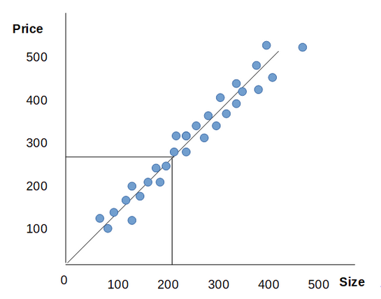
What is machine learning ?
The computer program A (the model)
Housing price prediction Using univariate linear regression
Size | Bedroom | Price *100$
120 | 4 | 400
150 | 3 | 300
200 | 4 | 400
...
300 | 5 | 600

Slide 9
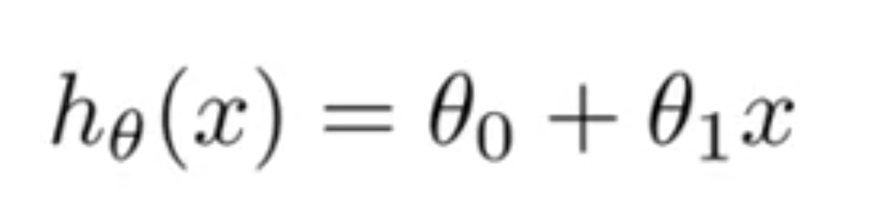
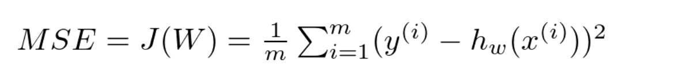
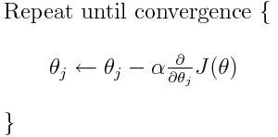
What is machine learning ?
The computer program A (the model)
Housing price prediction Using univariate linear regression
The main component of every model :
Architecture / Baseline :
Loss/objective function : Mean square errors
Optimizer: Gradient Descent
Evaluation Metric: Accuracy
Regulazer: L2 Norm

Slide 10
What is machine learning ?
Pseudo of code

Slide 11
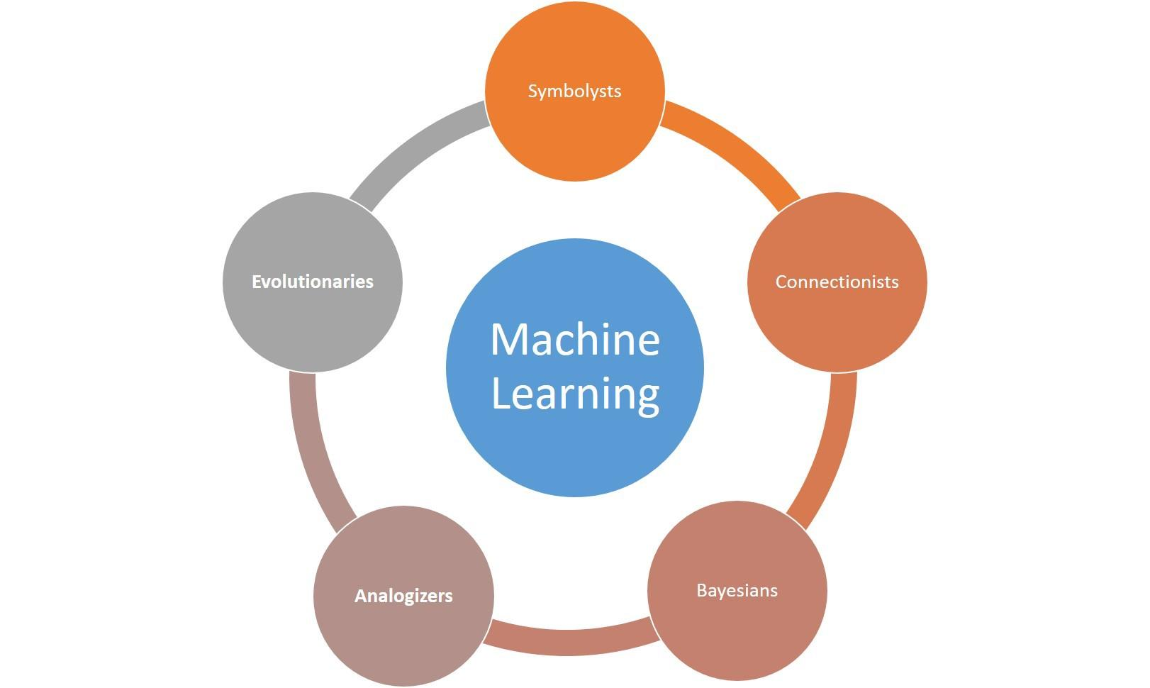
What types of models are there ?
The computer program A (the model)

Slide 12
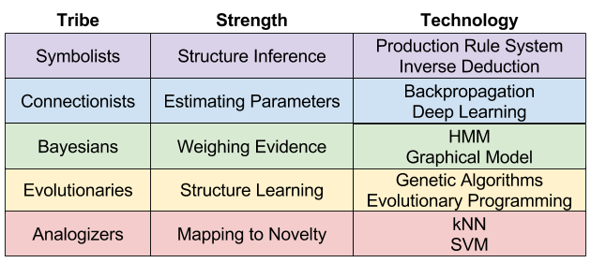
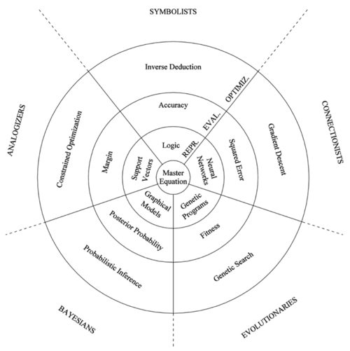
What types of models are there ?

Slide 13
Models examples ?
Analogizers Master Algorithm : Support Vector machine

Slide 14
Models examples ?
Connectionist Master Algorithm : Neural Network
Vanilla neural network

Slide 15
Models examples ?
Evolutionaries Master Algorithm : (pick a genetic algorithm)

Slide 16
Machine learning engineering workflow ?

